Slide 1
Rising Up in Times of Trial:
Examples of Those Who Have Gone Before
April 2, 2022

Slide 2
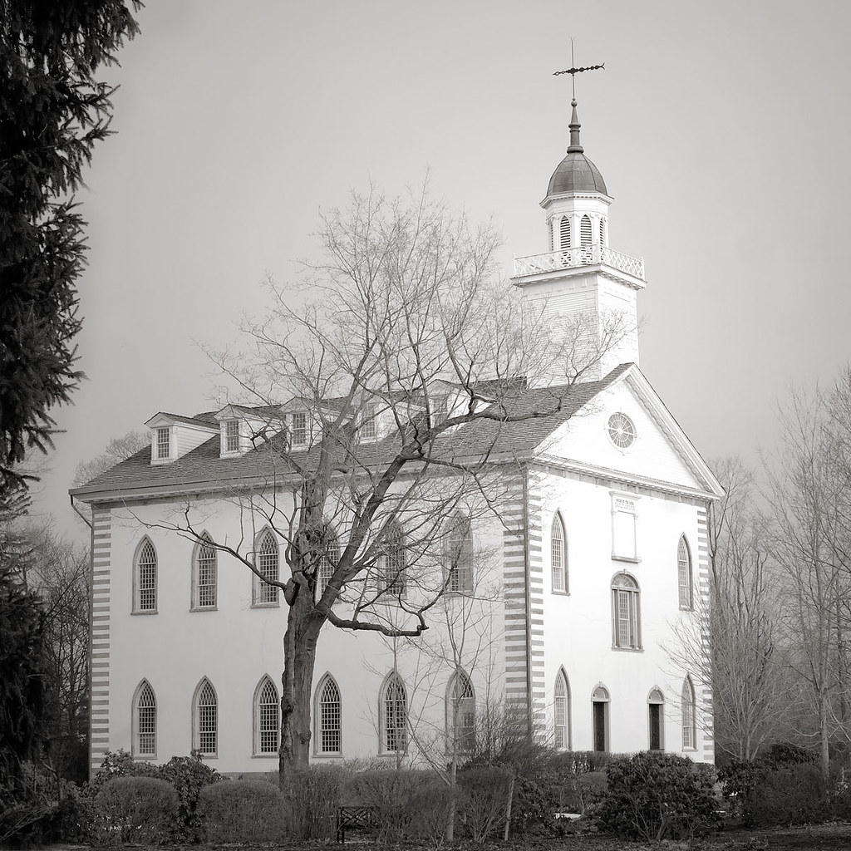
Rise up, Oh saints of God!
Have done with Lesser things;
Give heart and soul and mind and strength
To serve the King of Kings.
Rise up, Oh saints of God!
His kingdom tarries long;
Ring in the day of brotherhood
And end the night of wrong.
Rise up, Oh saints of God!
The Church for you doth wait.
Her strength unequal to her task;
Rise up, and make her great!
This Photo by Unknown Author is licensed under CC BY

Slide 3
Where should focus be?
Colossians 3:1-2
Matthew 6: 19-22
Matthew 6: 38
D&C 77: 4 d-e
“Courage is resistance to fear, mastery of – not absence of fear.”
– Mark Twain
Notes:
Col: 1-2 “If ye then be risen with Christ, seek those things which are above, where Christ sitteth on the right hand of God. Set your affection on things above, not on things on the earth.”
Matt: 19-22 “Lay not up for yourselves treasure upon earth, where moth and rust doth corrupt, and where thieves do not break through no steal. For where your treasure is, there will your heart be also. The light of the body is the eye; if therefore thine eye be single to the glory of God, thy whole body shall be full of light.”
Matt: 6: 38 “Wherefore, seek not the things of this world but seek ye first to build up the kingdom of God, and to establish his righteousness, and all these things shall be added unto you.”
D&C 77: 4d-e “wherefore do these things that I have commanded you, saith your Redeemer, even the son Ahman, who prepareth all things before he take you; for ye are the church of the Firstborn, and he will take you up in the cloud, and appoint every man his portion. And he that is a faithful and wise steward shall inherit all things. Amen.

Slide 4
Emma’s Bravery When Crossing the Mississippi
How long had the saints been in Missouri?
How would you describe the environment?
What struggles did the saints face?
What options did Emma have?

Slide 5
Emma Hale Smith
July 10, 1804 – April 30, 1879
October 27, 1838
Gov. Lilburn Boggs issued extermination order
December 1, 1838
Joseph Smith imprisoned
Church papers & IV manuscript given to Ann Scott Davis
Emma Smith & children leave MO with IV manuscript concealed beneath her skirts
Gospel Restored - Church Established
Aptil 6, 1830
Joseph Smith martyred June 27, 1844

Slide 6
Joseph Smith III
What stands out about his youth?
What was the purpose of his father’s blessing in Liberty jail?
What do we know of his faith, devotion and response to the Spirit?

Slide 7
Ralston’s Succession of Presidency
God chooses the prophet
God chooses the prophet’s successor
  Numbers 27:18-23
  Deuteronomy 34: 9
  Joshua 1: 1-15
  D&C 43: 1-2

Slide 8
Joseph Smith III - November 6, 1832 – December 10, 1914
October 27, 1838
Gov. Lilburn Boggs issued extermination order
April 6, 1860
Joseph III Reorganizes the Church at Amboy, IL - served as president & prophet 54 years
December 1, 1838
Joseph Smith imprisoned
Blessed – prophetic succession
Church papers & IV manuscript given to Ann Scott Davis
Emma Smith & children leave MO with IV manuscript concealed beneath her skirts
Gospel Restored - Church Established
Aptil 6, 1830
Joseph III Born
Joseph Smith martyred June 27, 1844

Slide 9
-Billy Graham
“Courage is contagious. When a brave man takes a stand, the spines of others are often stiffened.”
Fear thou not; for I am with thee; be not dismayed; for I am thy God; I will strengthen thee; yea, I will help thee; yea, I will uphold thee with right hand of my righteousness.”
Isaiah 41: 10

